Slide 1
Programming with B4X
Lesson 13 – XUI Views
Anywhere Software
March 2021

Slide 2
Today you will learn
What is a library.
XUI library.
Dialogs
Templates

Slide 3
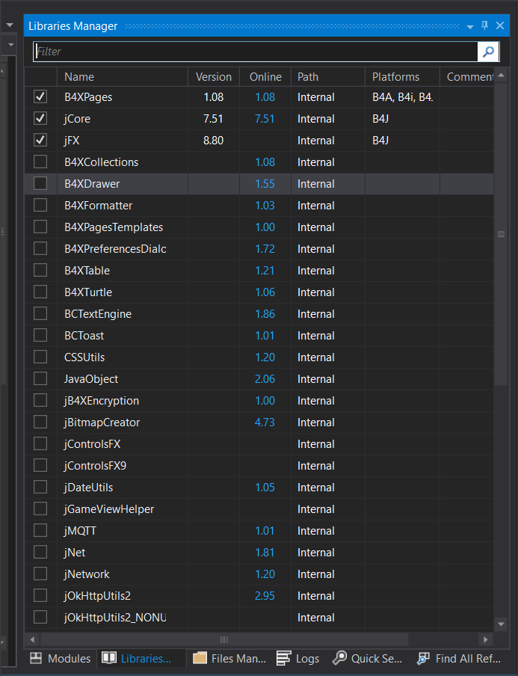
Libraries
A library includes collections of code, structures, classes, methods that can be used by developers to facilitate the process of developing a program.
Notes:
Libraries are generally divided into internal libraries and are those that are installed together with the language and external ones created by the de-veloper himself or found from other sources (e.g. Github). To use a library, you only need to select it from the corresponding Libraries list in B4X.
The list of libraries contains useful information. These are:
• the current version of the library that is installed,
• The latest version published in order to update our language.
• Whether it is an internal library or an external library.
• Which platforms it concerns.
To use a library, you must have been informed about the functions it per-forms as well as the data and methods it uses. For each library there is relevant information about its use through the language website at https://www.b4x.com/android/documentation.html.

Slide 4
XUI Views library
The purpose of the XUI Views library is to offer a common way to create ap-plications for b4j, b4a and b4i.
This library is associated with creating forms and views that are included in them.

Slide 5
Using XUI Views
To use the XUI Views first you need to check its name on the library tab.
Then go to the Designer to create the objects you want

Slide 6
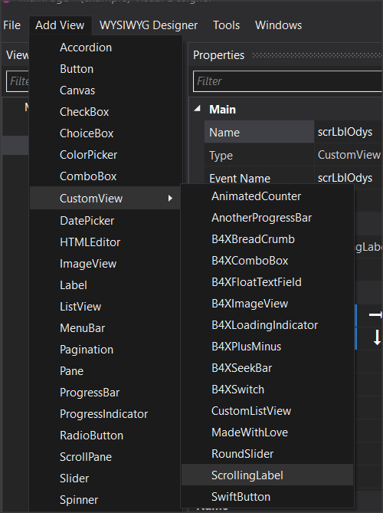
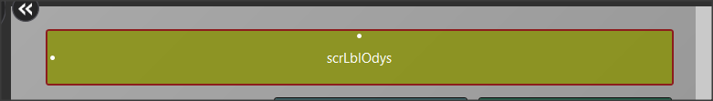
Scrolling Label
Scrolling label is a text label where it can move text so that it can appear in its entirety

Slide 7
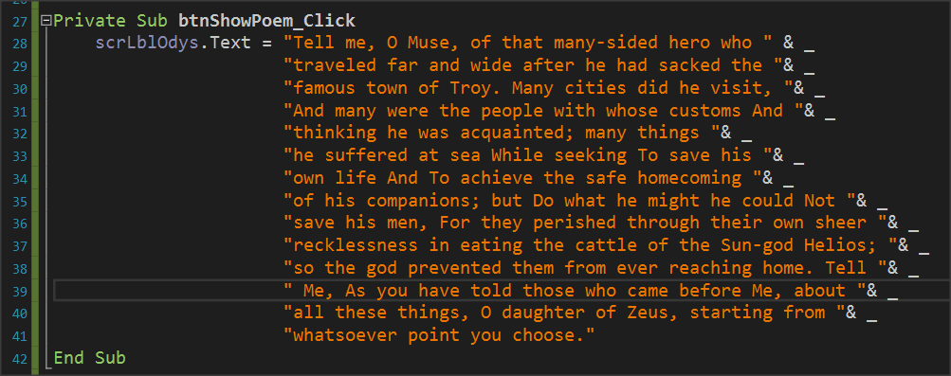
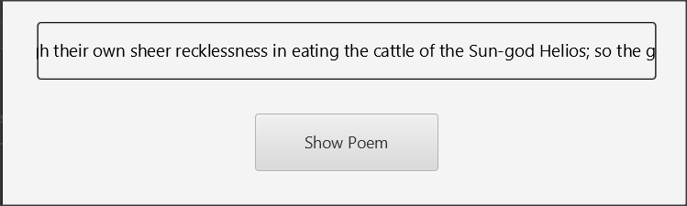
Scrolling Label
It is mainly used for very large texts or to display a running message on the screen.

Slide 8
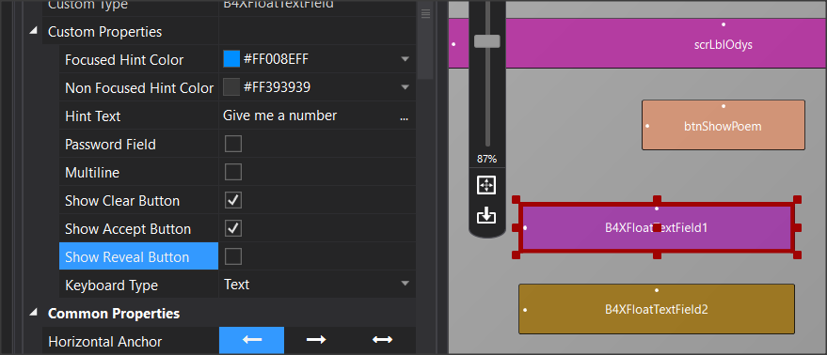
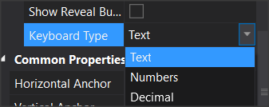

B4XFloatTextField
Notes:
B4XFolatTextField creates a text box on the screen to insert data. Its use is similar to the simple text box, but in addition it displays a label that helps the user identify the field without inserting an additional label before the field ( Hint Text). Additionally, it displays the appropriate controls to delete or enable this field (Show Clear Button, Show Accept button). Finally, it allows the Keyboard Type property to enter text, either integer numbers or decimal numbers.

Slide 9
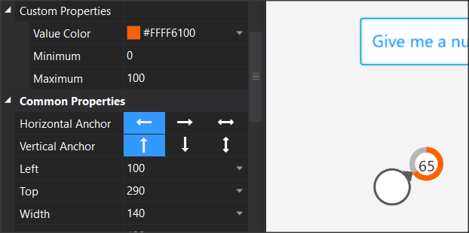

RoundSlider
Notes:
Each time the RoundSlider value changes, the "_ValueChanged" event is triggered, and gives a value of which the developer can use.
RoundSlider is a controller that moves with the mouse around a circle. Each point in the cycle, it displays a value from a range of values that you have selected in the Minimum – Maximum properties in Designer.

Slide 10
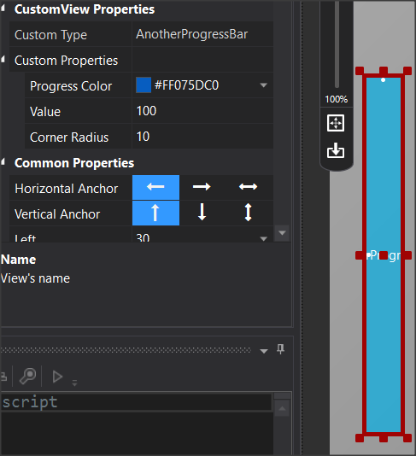
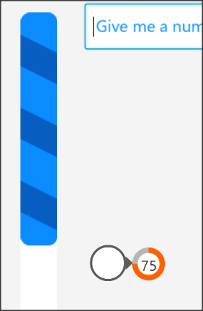
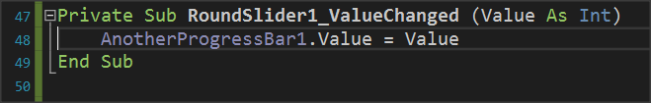
AnotherProgressBar
Notes:
AnotherProgressBar displays a bar that vary between 0 and 100 and is suit-able for displaying percentages or other proportions. Using it is simple, after you declare the variable that corresponds to the item, use the property ".value" to set a value.
In the example of the image, progressBar vary depending on the value it receives from RoundSlider.

Slide 11
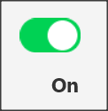
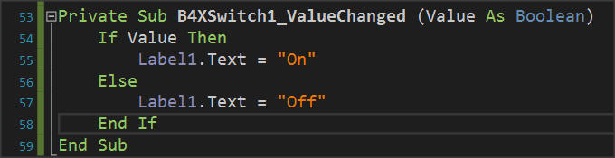
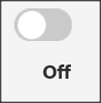
B4XSwitch
Notes:
B4XSwitch creates a sliding button on the screen.
In the example of the image when the returned value is true then a label displays the text "On" otherwise displays "Off".

Slide 12
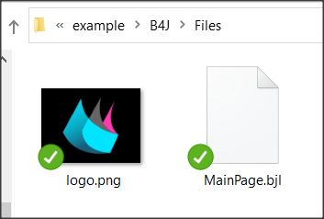
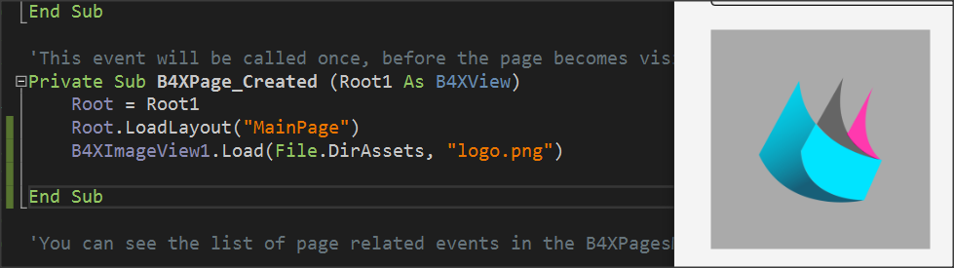
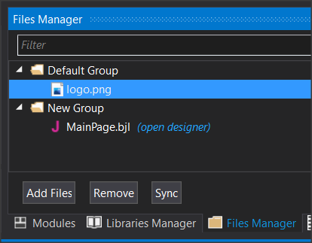
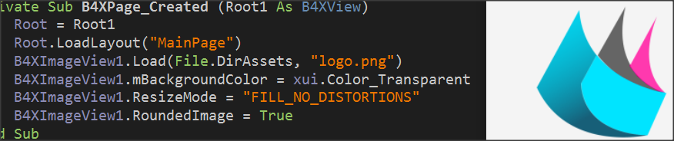
B4XImageView
Notes:
B4XImageView displays an image. Provides the ability to choose how the image is displayed either by code or by the object's options in Designer.
In the Load command, in addition to the image name, the folder where the image is stored must be declared first. In this case, the Files (Files.DirAsset) folder is declared as in the image below:
This folder is not accessible for writing new files when the application is cre-ated. In the course of the files, we will refer in greater detail to the folders.
To display an image stored in the Files folder, it must also be declared on the File Manager tab of the language.

Slide 13
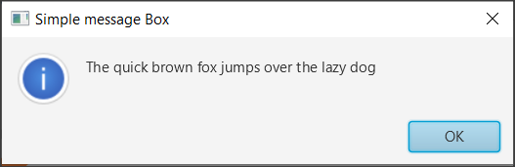
B4XDialogs – xui.MsgboxAsync
Notes:
Accepts two parameters, the first is the message you want to display, and the second is the title of the window. The command also displays an OK button to close the message and return to the program.

Slide 14
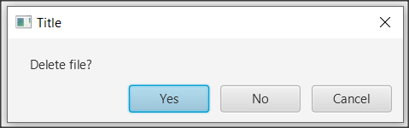
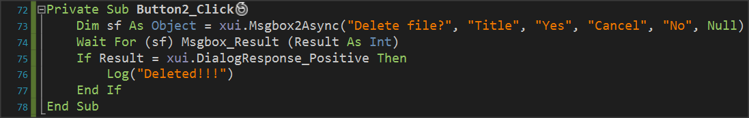
B4XDialogs – xui.Msgbox2Async
DialogResponse_Positive (if “Yes” was pressed)
DialogResponse_ Negative (if " No" key was pressed)
DialogResponse_Cancel (if "Cancel" was pressed)
Wait For
Wait For freezes the execution of an operation until an event is activated.
Wait For (<sender>) <event signature>
Notes:
Using MsgBox2Async is more complex and allows the programmers to display a message and then choose between three different functions by pressing a corresponding button.
The above values are controlled by an if command and appropriate actions are performed accordingly.
The words that appear on the action buttons can be changed but always have the same order as a “Positive”, “Cancel”, “Negative”.
You can skip a button simply by writing a blank string "" at the correspond-ing point when the button will not appear in the dialog box.
The last parameter allows you to display an icon to the left of the message, and Null displays nothing.
Where sender is the object for which an event is waiting to be activated and
Event signature the event that was activated where in the case of MsgBox2 Async are the DialogResponse_Positive, DialogResponse_Cancel, DialogResponse_Negative.
The event is then checked with an if command.

Slide 15
CustomDialog
Create a Form in Designer
In code: Make a pane and set size
Load Form in Pane
Wait For event
Check Event with IF
Notes:
Creating a Custom dialog box includes several steps that start with the Designer

Slide 16
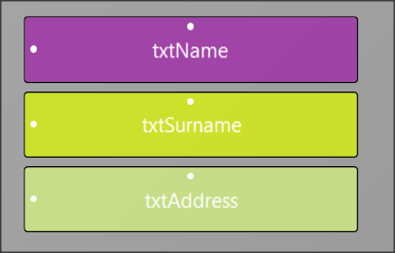
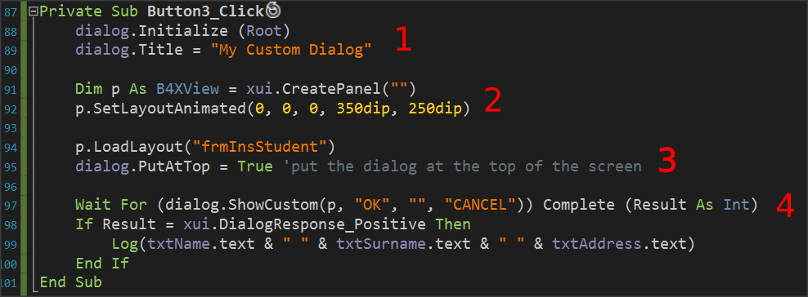
CustomDialog
Notes:
1.Set an object named dialog type B4XDialog within globalSub, and then use the command “dialog.Initialize(Root)” to initialize it. “dialog” sets a title in the dialog box that you are about to create.
2.Set a pane in which to display the items on the form you designed and set its dimensions in pixels.
3.Load your form with the “p.LoadLayout” command where “p” the pane you set before and then set to appear at the top above all other windows.
4.Wait for a button to click and check the results.

Slide 17
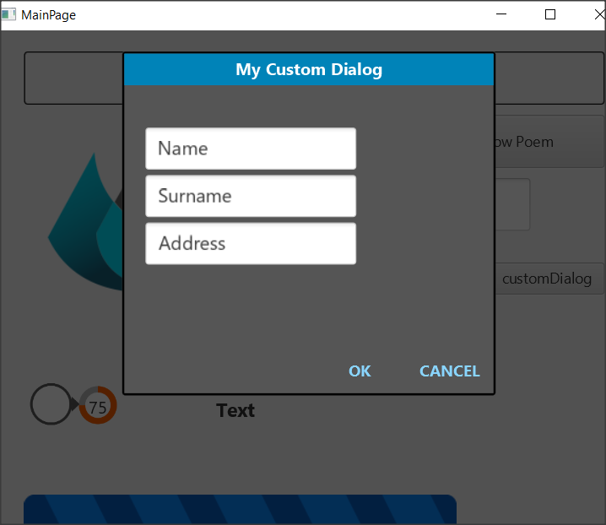
CustomDialog

Slide 18
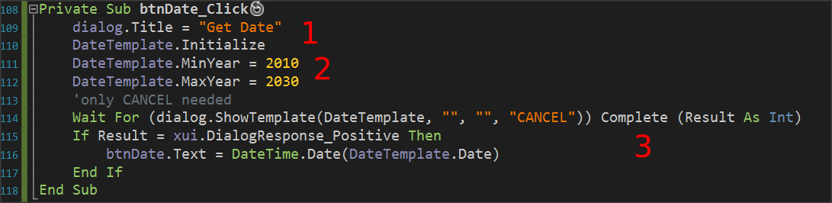
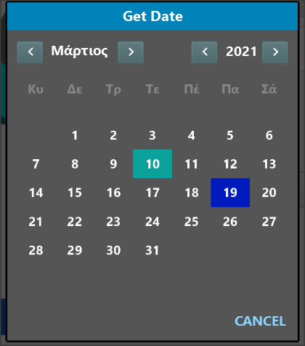
Templates - B4XDateTemplate
The date is returned to Ticks which represent milliseconds from 1/1/1970. These milliseconds are converted to a date with the “DateTime.Date” command.
Initialize and set a title in the dialog. In the example initialization done in Class_Globals Sub.
Specify whether you want years limits.
Wait for the date to be selected, and if selected, display it as a name on the “btnDate” or use it according to your needs
Notes:
Creates a Dialog box to select a date. This box only needs a cancel button because when a date is selected it automatically returns the relevant value to the program. When the form opens, it has already marked the current date in a different color. B4XDateTemplate based on a dialogue template that should be declared and initialised as in the Custom Dialogs

Slide 19
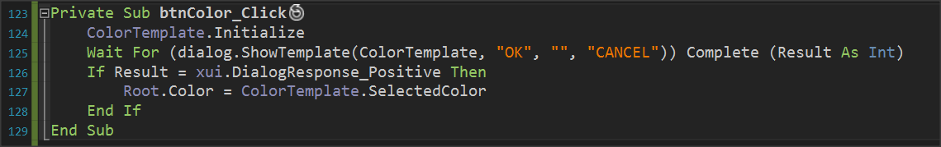
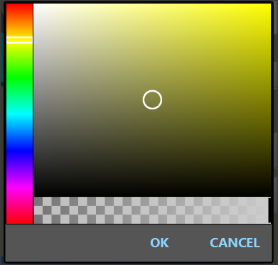
B4XColorTemplate
Root.Color Sets the background color of your application
Notes:
B4XColorTamplate is similar to that of the day. Once again the code is waiting with the Wait For command to make a color selection, and when pressed OK returns a color number.
The example uses the color to change the background of the home page with the “Root.Color”.

Slide 20
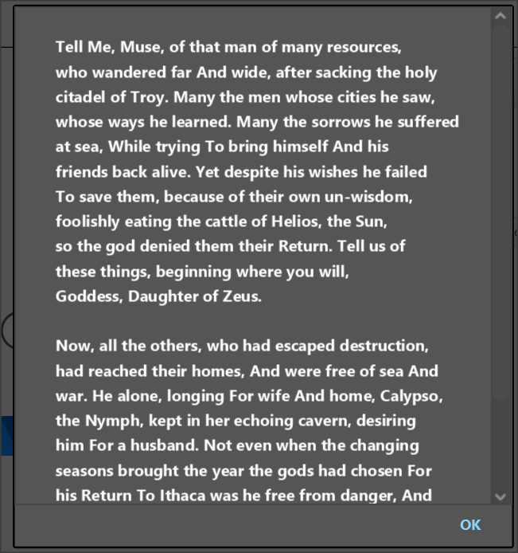
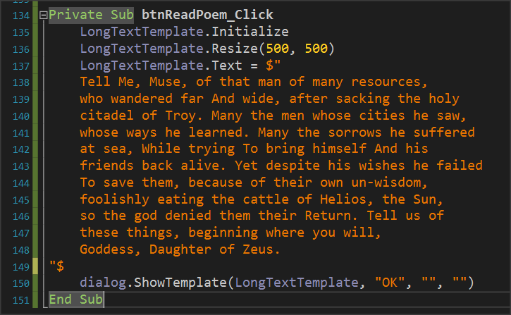
B4XLongTextTemplate
Notes:
B4XLongTextTemplate displays a window on the screen to display long text. Also, it displays a navigation bar to scroll the text. As in previous templates, set a variable of type B4XLongTextTemplate, and then after you initialize it you can set a size for the window that you are going to create with the “Resize” command.
Finally, set the Text property to the text you want to display and call “ShowTemplate”.

Slide 21

Thank you!!!

